Slide 1
License Plate Recognition Using Raspberry Pi & Amazon Rekognition OCR Engine
Final Presentation
By: Daemon Macklin, William Zhang, Andy Wong and Joseph Rodrigues
Professors: Dr. Kumar Yelamarthi
& Dr. Frank Walsh
Notes:
Andy

Slide 2

Introduction & Rationale
Our project is an automated system that scans license plates and queries them through a database, sending notifications to the user if certain documents are attached to the plate.
Typical use of this is for a police officer driving in traffic.
Notes:
Andy

Slide 3

Technologies Used
Amazon Rekognition
WIA Cloud Interface
Glitch.me Web API
MongoDB
Raspberry Pi 3 B+
Program running within Pi is written in Python.
Logitech C270 USB Camera (CMU) or Raspberry Pi Camera Module (WIT)
Notes:
Andy

Slide 4
Previous Work
Similar and previous implementations of projects similar to this used a different OCR system, Tesseract.
Involved more image processing. Usually a combination of Tesseract and OpenCV
Added vehicle recognition in combination with License plate detection.
Our project differs in that we use Amazon Rekognition, a more user friendly OCR system. Additionally our project implements cloud connectivity, searching OCR results through a cloud database.
Lyu, Hao. Automatic Vehicle Detection and Identification using Visual Features, University of Windsor (Canada), Ann Arbor, 2018. ProQuest, http://cmich.idm.oclc.org/login?url=https://search-proquest-com.cmich.idm.oclc.org/docview/2015699068?accountid=10181
“Detecting Text Based Image with Optical Character Recognition for English Translation and Speech Using Android.” Research and Development (SCOReD), 2015 IEEE Student Conference On, by Sathiapriya Ramiah et al., 2015, pp. 272–277
Notes:
Joseph Rodrigues

Slide 5

Amazon Rekognition
Amazon Rekognition is an API that performs image analysis, in our case optical character recognition. Taking an image with a license plate in it and converting the image text to a string.
Notes:
Joey

Slide 6

Wia Cloud Interface
Wia is a cloud service used to simplify cloud infrastructure, connecting hardware and software. Also provides a wrapper to allow the basic usage of Amazon Rekognition’s image processing capabilities.
Notes:
Joey

Slide 7
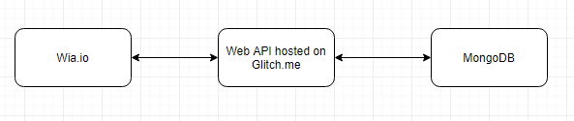
Glitch.me Web API
Glitch.me is a hosting site for our Web API that acts as a tool to for the interaction between WIA and the MongoDB holding plate information.
Notes:
Joey

Slide 8

MongoDB
A MongoDB is a cross-platform document oriented database program. This is where license plate information is stored, simulating the police database.
Notes:
Daemon

Slide 9
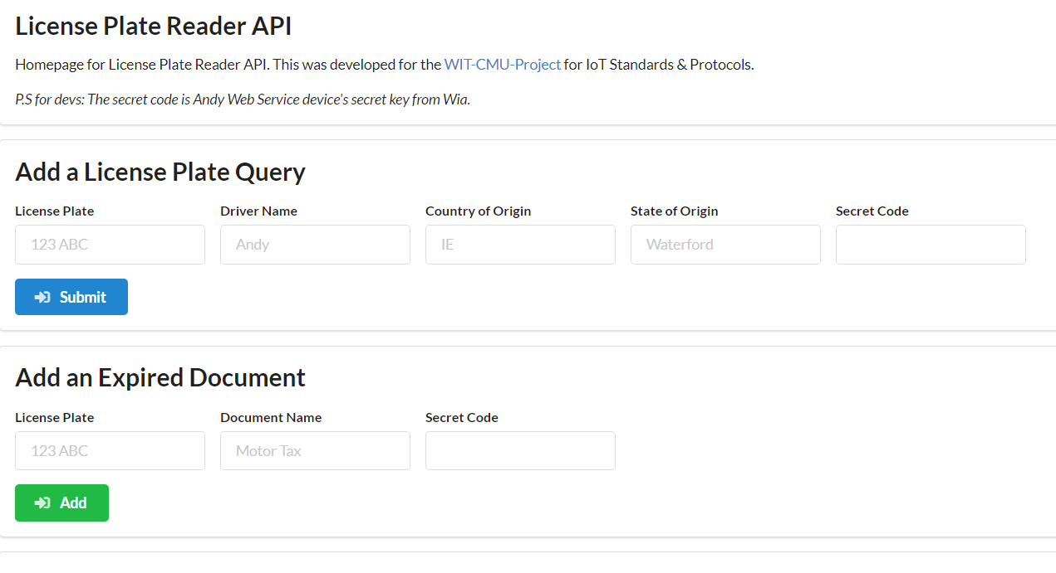
Glitch.me Registration web API Jump
Interactive web page that allows user interaction with MongoDB database; Adding or deleting license plates as well as listing expired documents etc.
Notes:
Daemon

Slide 10
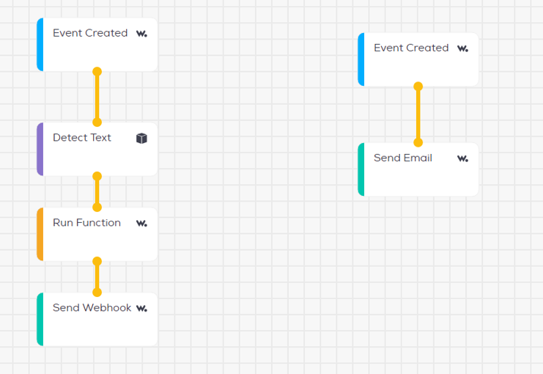
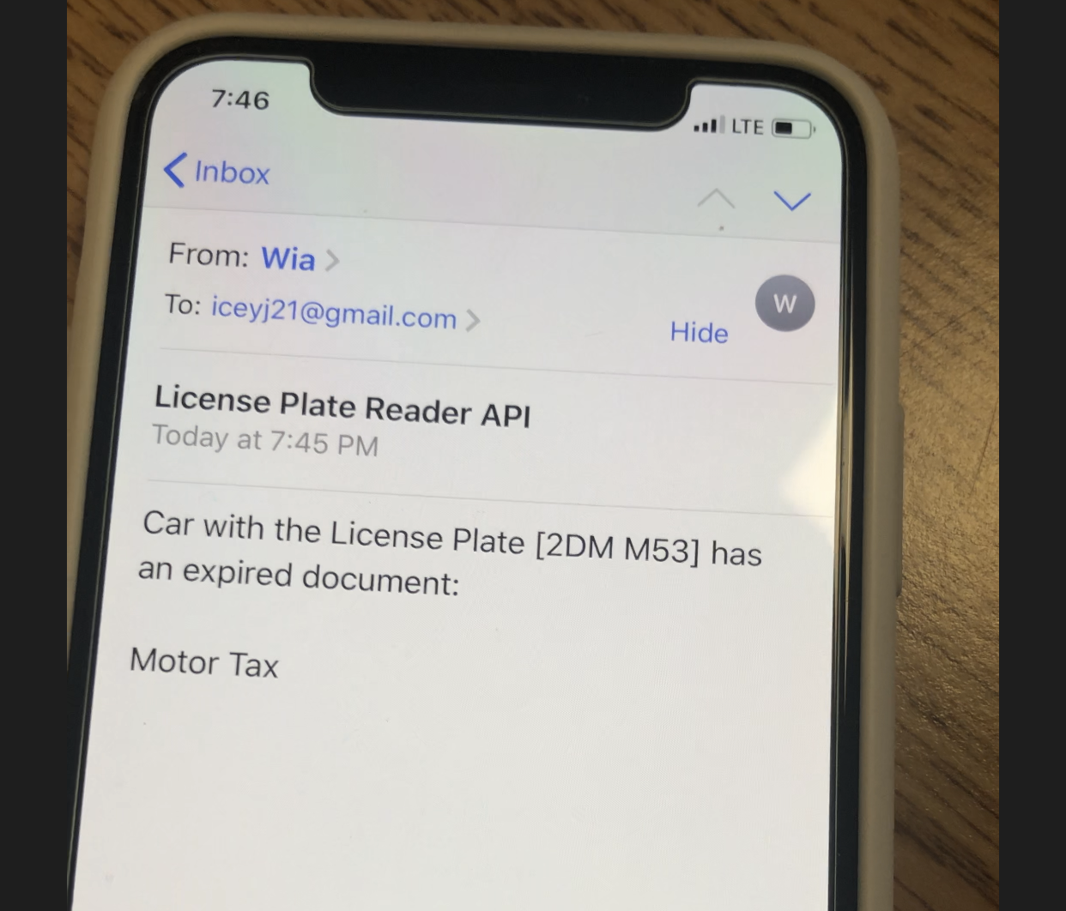
Wia Structure
The python script first takes and sends a picture to WIA where it then triggers the flow shown in the slide.
Notes:
Daemon

Slide 11
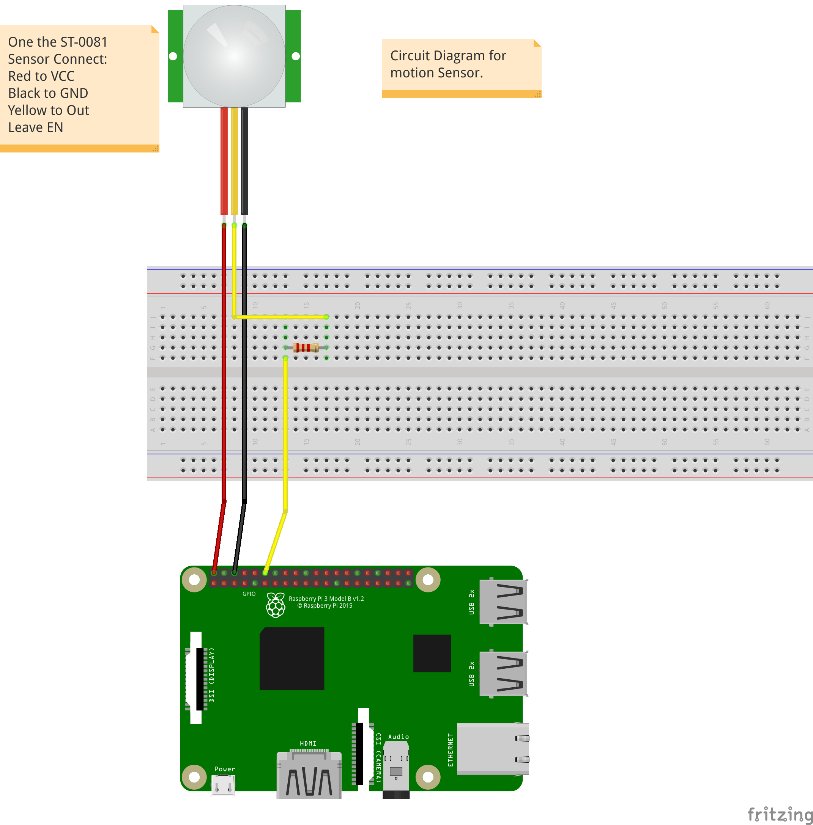
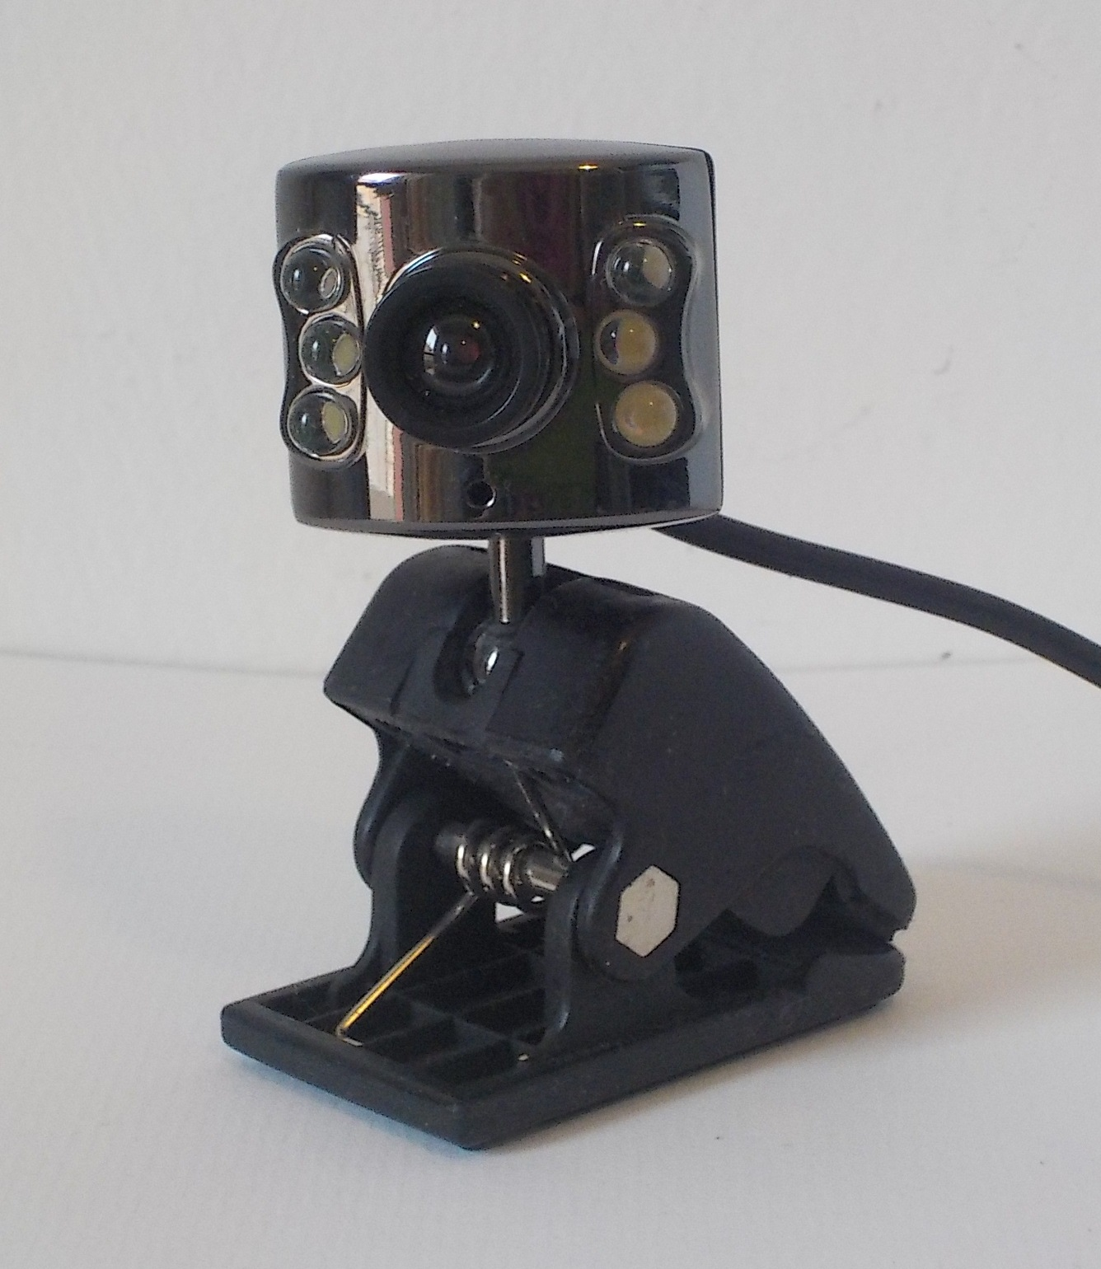
Physical Connection
(RPi,a USB Camera and ST-0081 motion sensor)
Notes:
Daemon

Slide 12
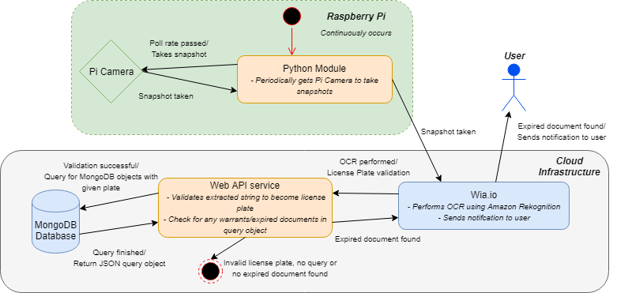
Method Flow Chart
Notes:
william

Slide 13

Evaluation & Results
Successful Character Recognition.
Interconnectivity between hardware and cloud. (RPI to WIA, Web API and MongoDB)
Based on these results, successful character recognition takes place in combination with the cloud analysis, querying the plate scanned through the simulated police database, returning relevant information to the user if applicable.
Notes:
william

Slide 14

Conclusion
Video
Based on our benchmarks established:
Successful OCR.
Interconnectivity between hardware and all systems of the project.
This project can be deemed a success.
Notes:
william

Slide 15

Questions?

